Slide 1

NETWORK MINER BY DIVYAM SHARYAN

Slide 2
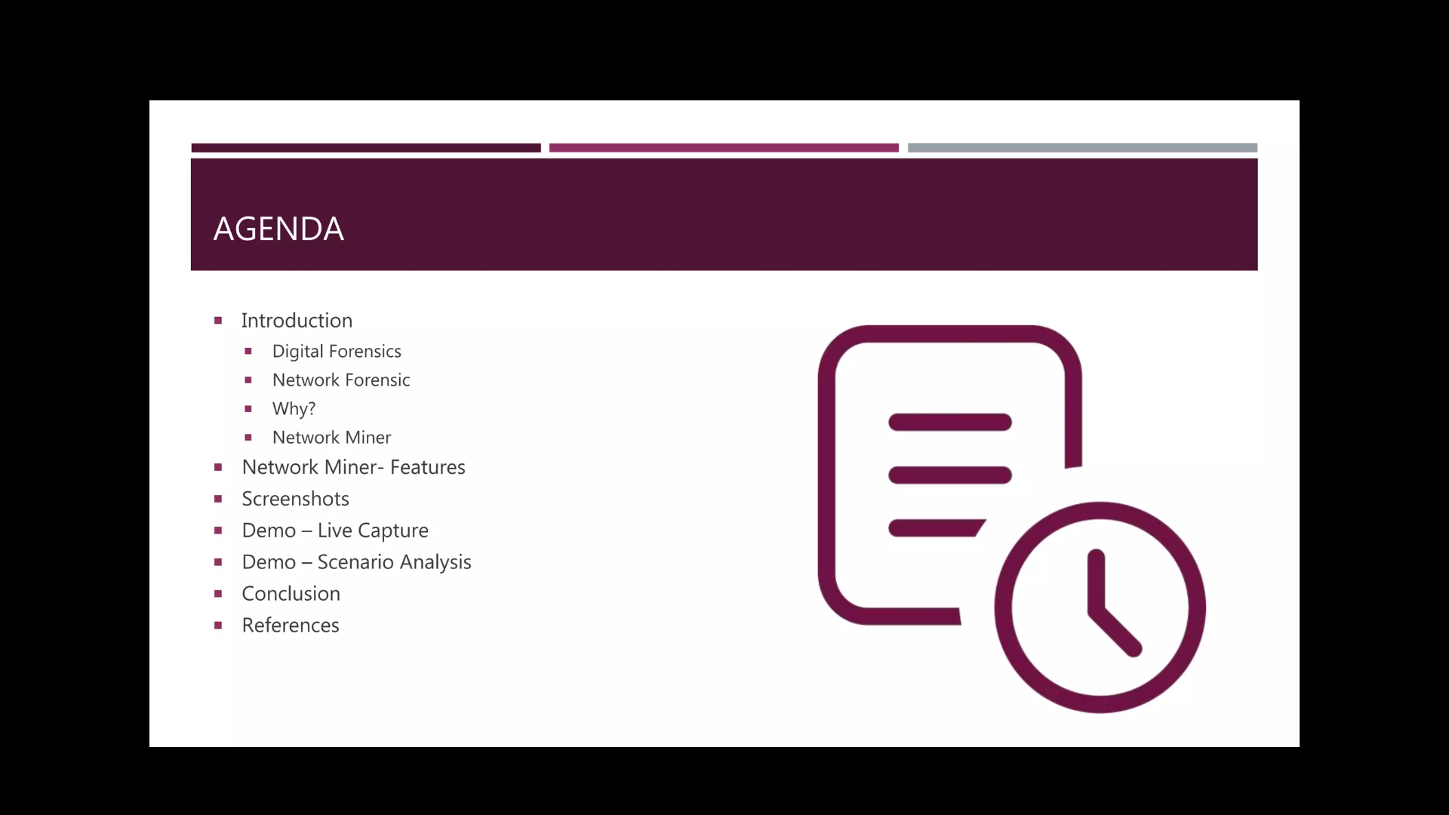

Slide 3
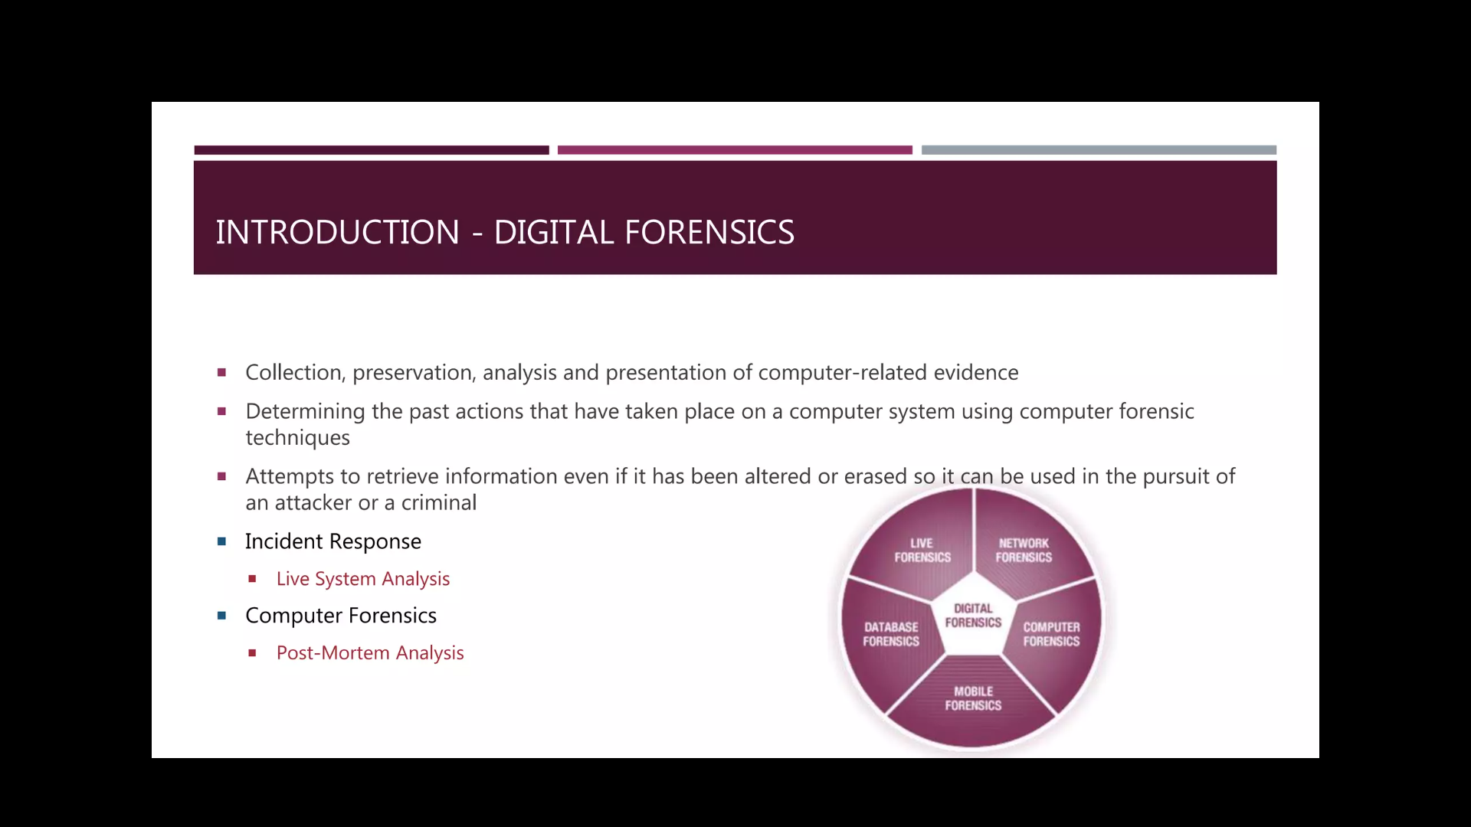

Slide 4
TYPES OF COMPUTER FORENSICS
DATABASE FORENSICS The examination of information contained in databases, both data and related metadata.
EMAIL FORENSICS The recovery and analysis of emails and other information contained in email platforms, such as schedules and contacts.
MALWARE FORENSICS Sifting through code to identify possible malicious programs and analyzing their payload. Such programs may include Trojan horses, ransomware or various viruses.

Slide 5
MEMORY FORENSICS Collecting information stored in a computer's random-access memory (RAM) and cache.
MOBILE FORENSICS The examination of mobile devices to retrieve and analyze the information they contain, including contacts, incoming and outgoing text messages, pictures and video files.
NETWORK FORENSICS Looking for evidence by monitoring network traffic, using tools such as a firewall or intrusion detection system.

Slide 6
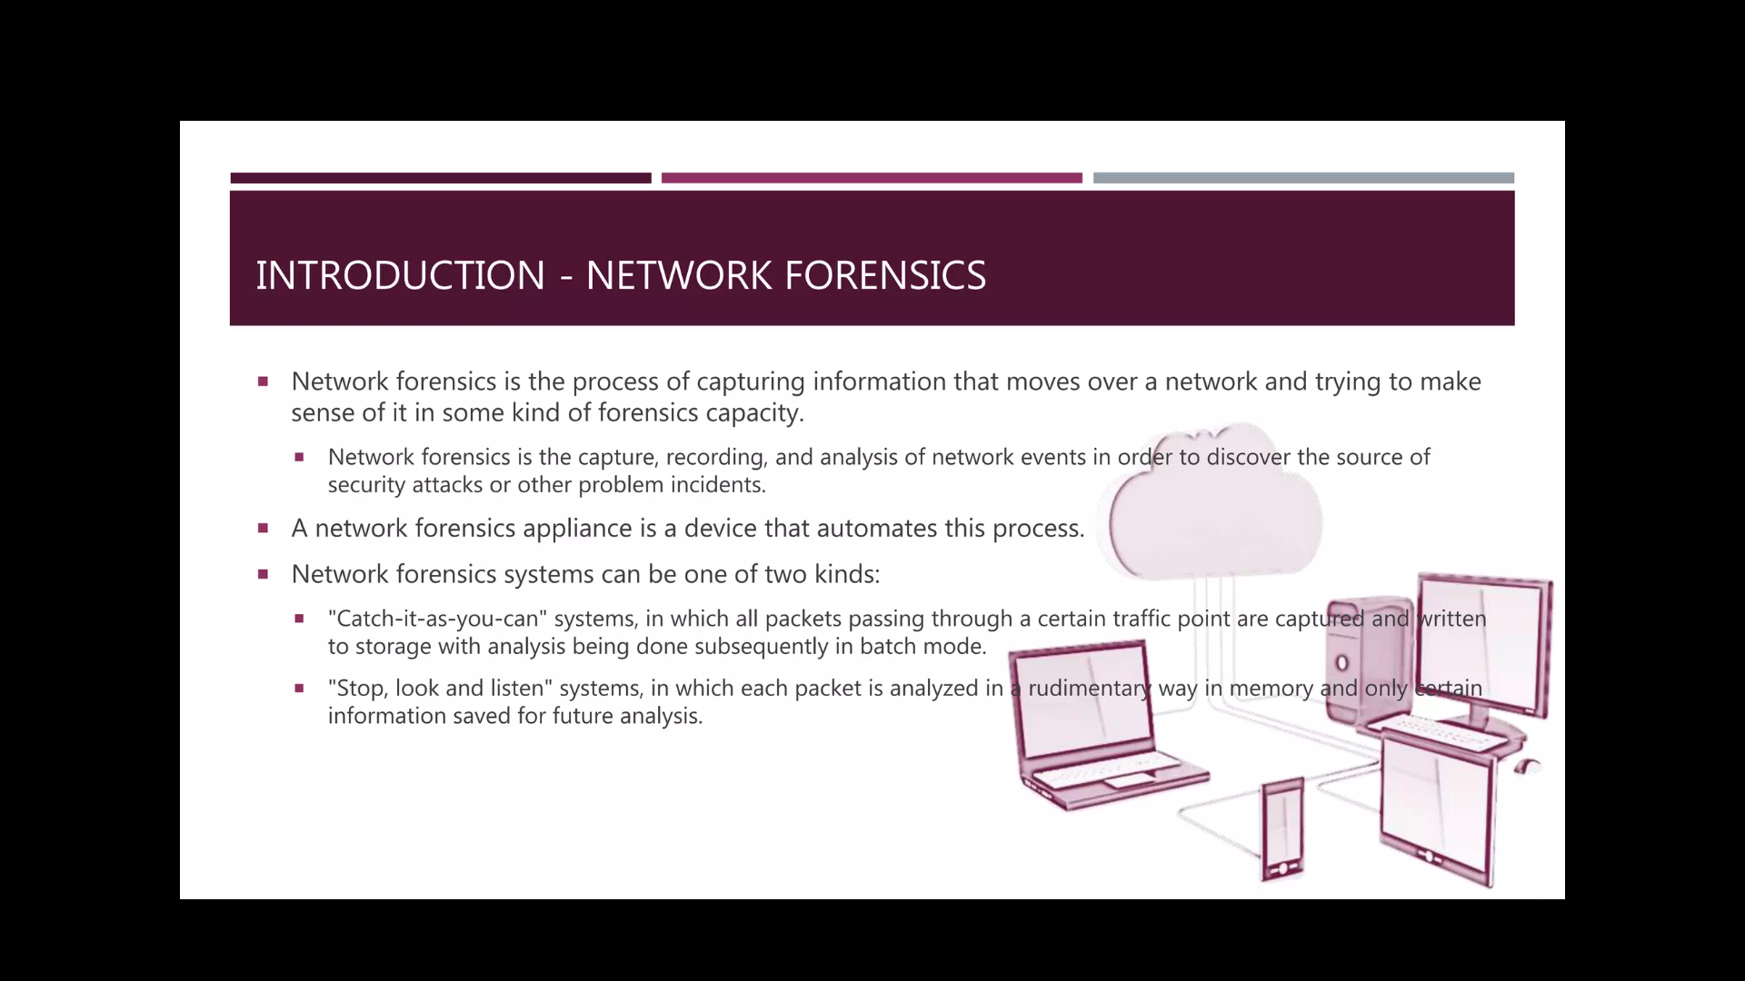

Slide 7
CATCH-IT-AS-YOU-CAN All packets are sent through a traffic point where they are stored in a database. After that, analysis is performed on stored data. Analysis data is also stored in the database. The saved data can be saved for future analysis. It should be noted, though, that this type of system requires a large storage capacity
STOP, LOOK AND LISTEN system is different from the “Catch-it-as-you-can” system, since only data required for analysis is saved into database. The incoming traffic is filtered and analyzed in real-time in memory, which means this system requires less storage but a much faster processor.

Slide 8
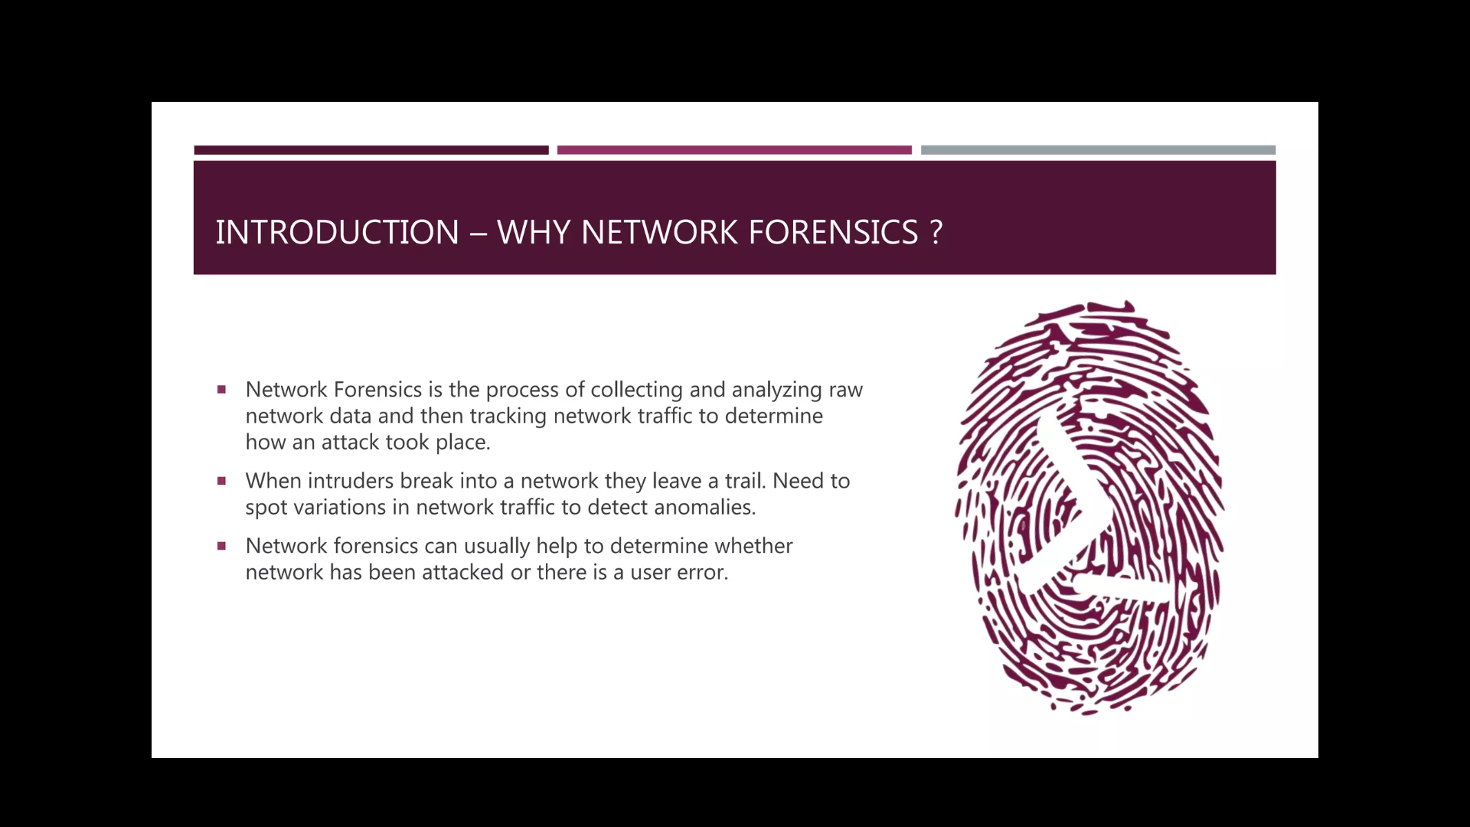

Slide 9
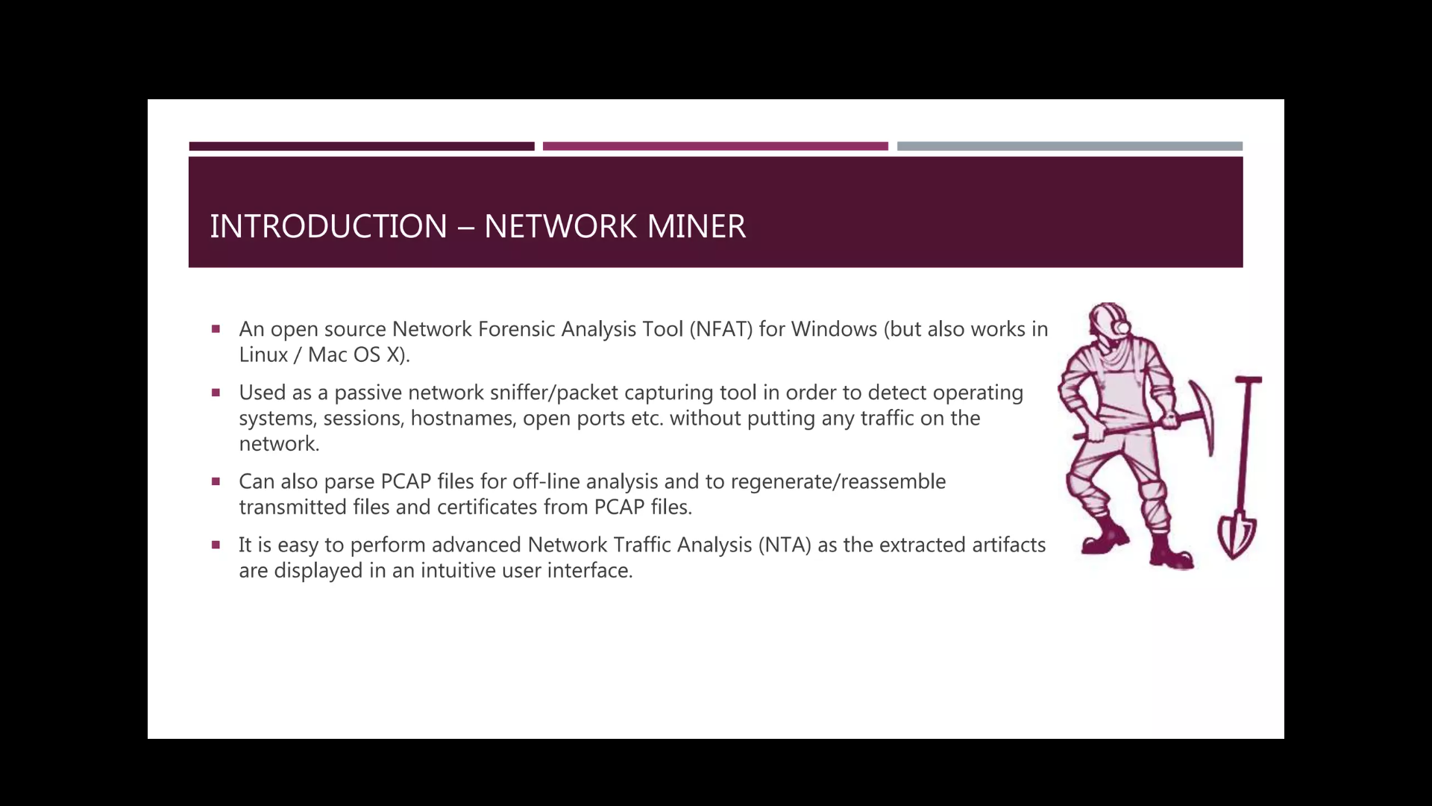

Slide 10
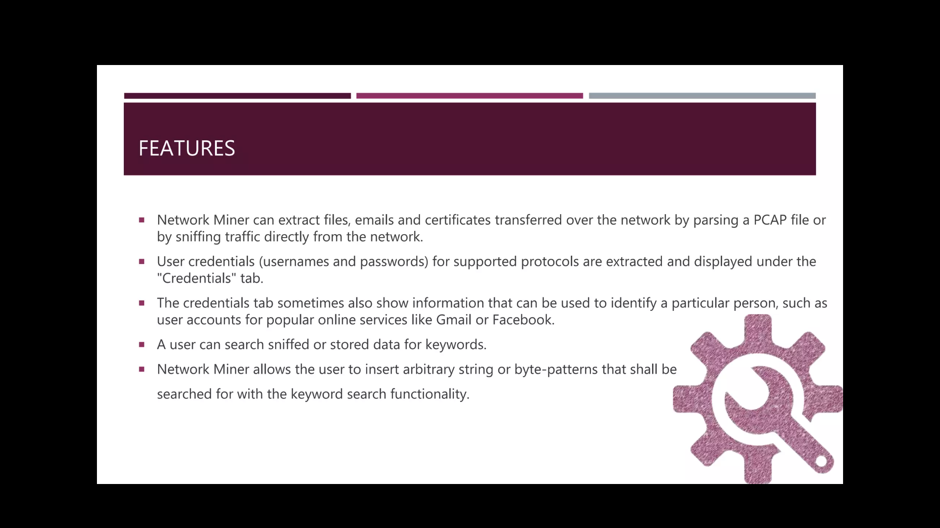

Slide 11
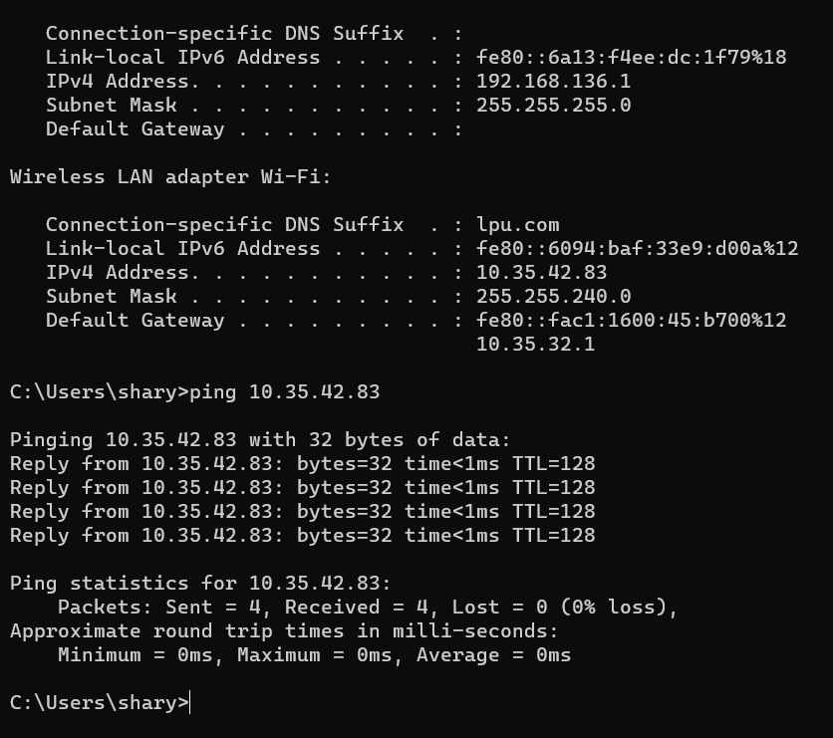

Slide 12
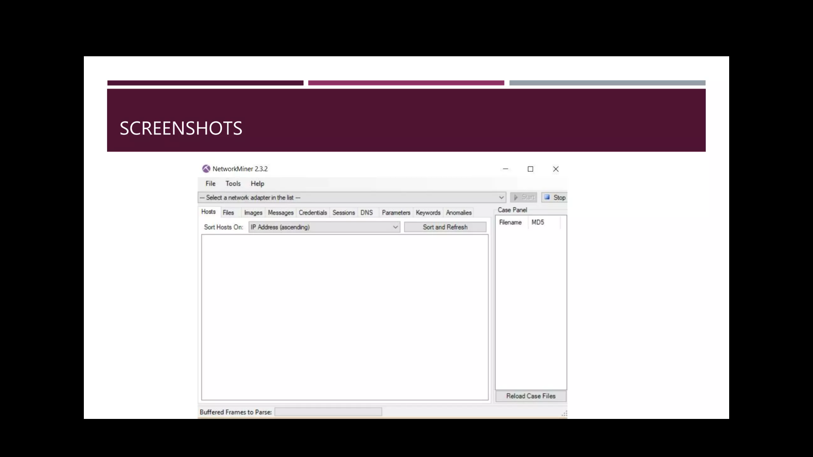


Slide 13
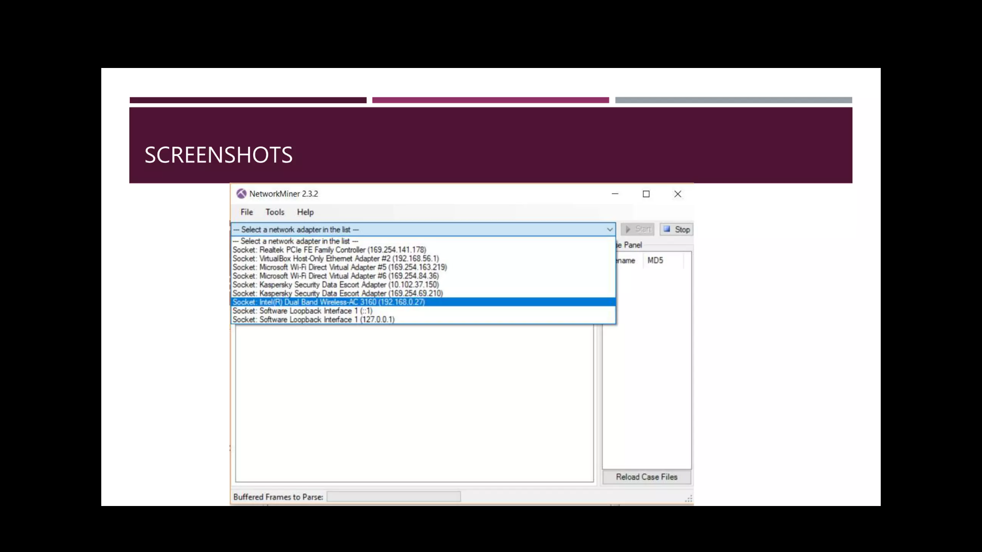
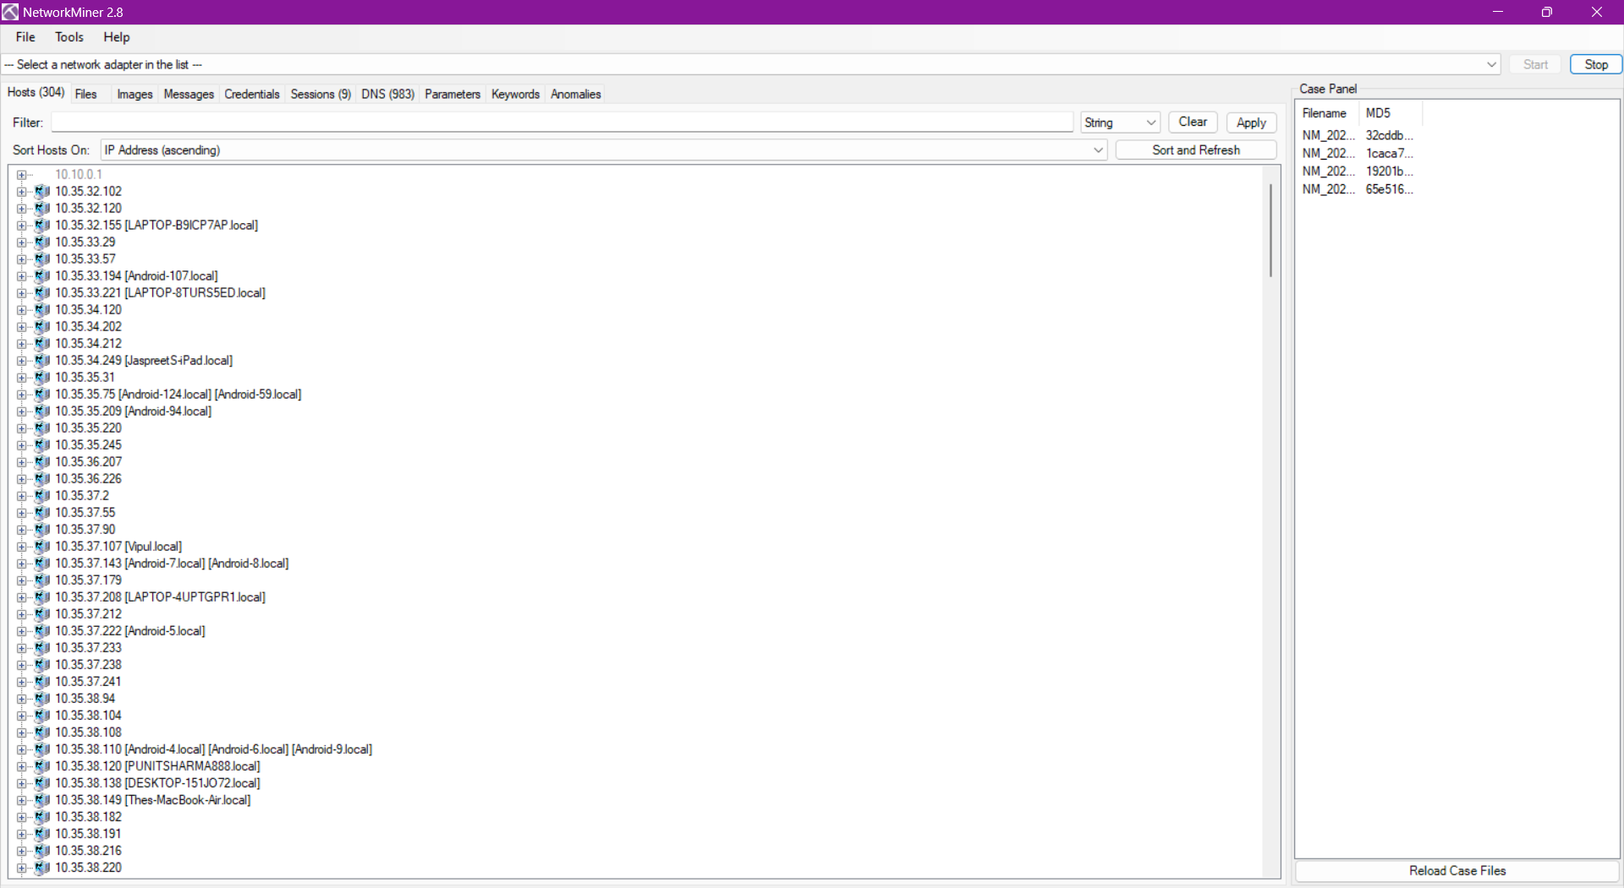

Slide 15
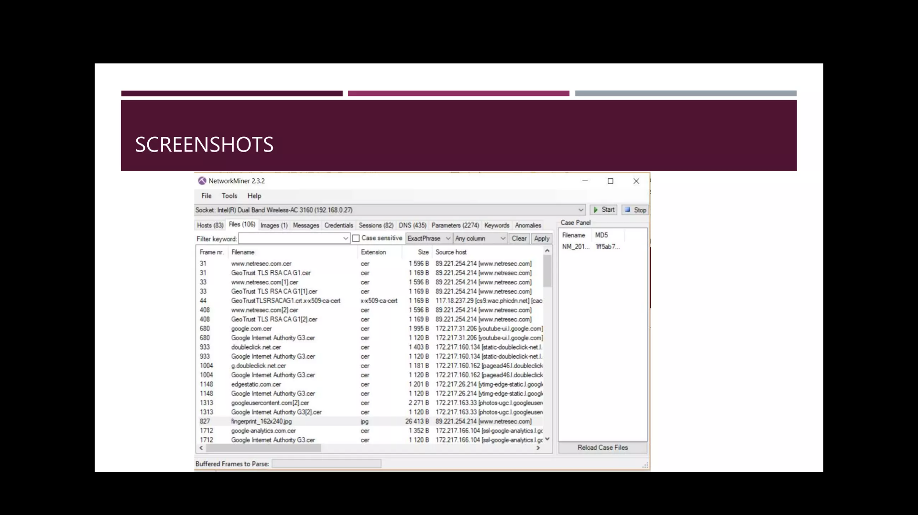
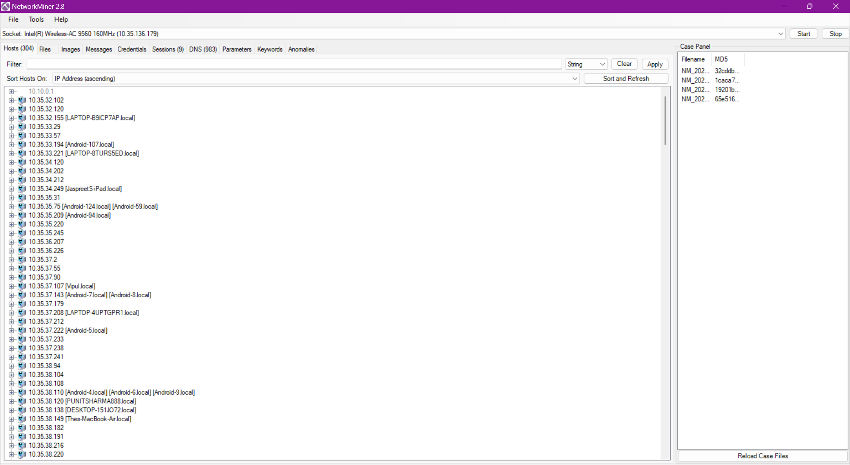

Slide 16
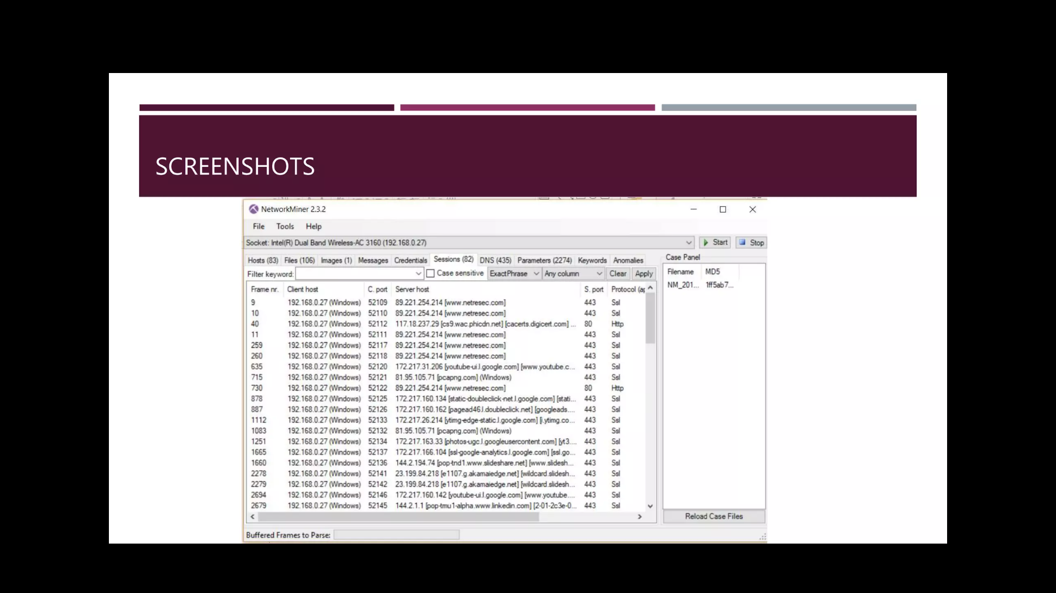
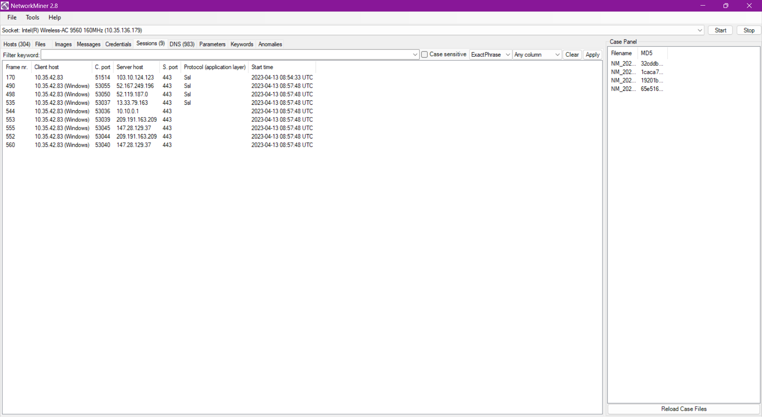

Slide 17
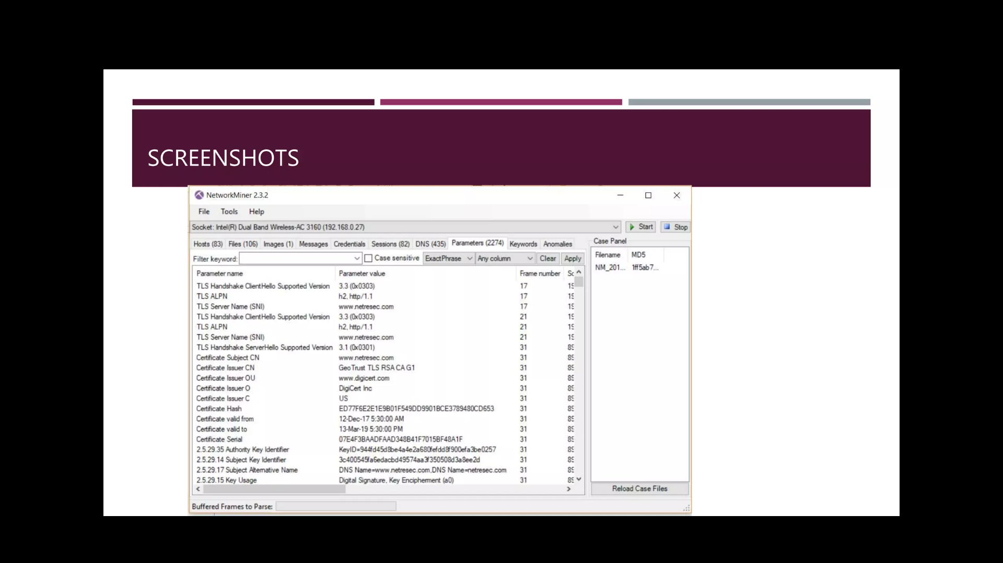
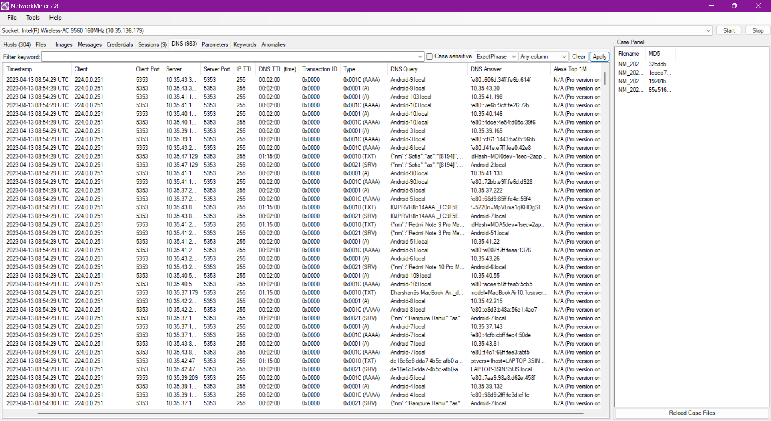

Slide 18
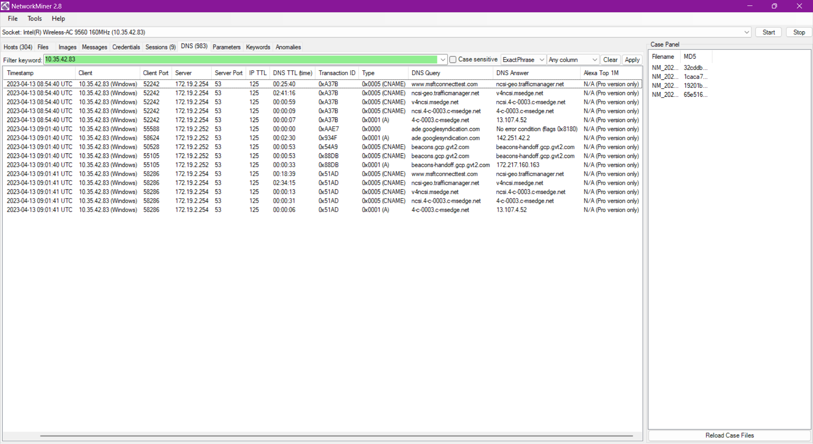

Slide 19
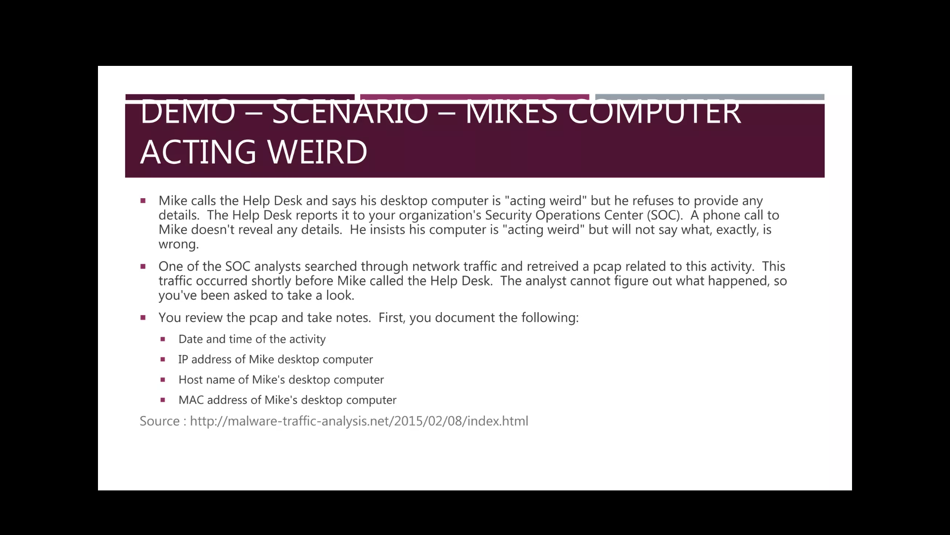

Slide 20
